Slide 1
Chicago Crime Analysis & Prediction
Presented by:
Farzeem Jiwani, Agha Ahmad & Faheem Mohammed

Slide 2
Problem
Description
01
Work
Distribution
02
Data
Specification
03
TABLE OF CONTENTS
04
05
Methodology &
Tools Used
Implementation Overview
06
Presenting Insights
07
Future Work
08
Conclusion

Slide 3
Problem Description
With the increase of crimes, law enforcement agencies are continuing to demand advanced geographic information systems and new data mining approaches to improve crime analytics and better protect their communities.
The primary objective is to perform predictive analysis on the dataset to comprehend whether crime is a function of locality, time, climate, or any external features, along with analyzing its trends over the years. This could be helpful to law enforcement to take appropriate measures about the When-What-Where of the crime i.e. when and what type of crime could happen in what locality.

Slide 4


Work Distribution!
Agha Anas Ahmad
Farzeem Jiwani
Faheem Mohammed
Pyspark SQL, Hive
Pyspark, EDA, Predictive Modelling
HDFS, Hive, Project Integration

Slide 5
Dataset Specification
1.8 GB
7.5 million
22
Chicago Police Department's CLEAR (Citizen Law Enforcement Analysis and Reporting) system: https://data.cityofchicago.org/Public-Safety/Crimes-2001-to-Present/ijzp-q8t2/data
Size
Rows
Attributes

Slide 6
Key Attributes
Attribute | Description
Date | Best estimate Date when the incident occurred.
Block | Partially redacted address where the incident occurred.
IUCR | The Illinois Uniform Crime Reporting Code is used to classify criminal incidents when taking individual reports.
Primary Type | Primary description of the IUCR code.
Description | Secondary description of the IUCR code.
Location Description | Description of the location of the incident.
Arrest | Indicates whether an arrest was made.
Domestic | Indicates whether the incident was domestic-related.
District | Indicates the police district where the incident occurred.
Community Area | Indicates the Community area where the incident occurred.
Year | Year the incident occurred.
Latitude | Latitude of the location where the incident occurred.
Longitude | Longitude of the location where the incident occurred.
Location | Combination of Latitude and Longitude.

Slide 7
Implementation Overview
HDFS Data Storage & Management
Spark Data Processing
Engine
Spark SQL Data Querying
Layer
Hive Data Warehouse & Organization
Scikit-learn Predictive Modelling

Slide 8
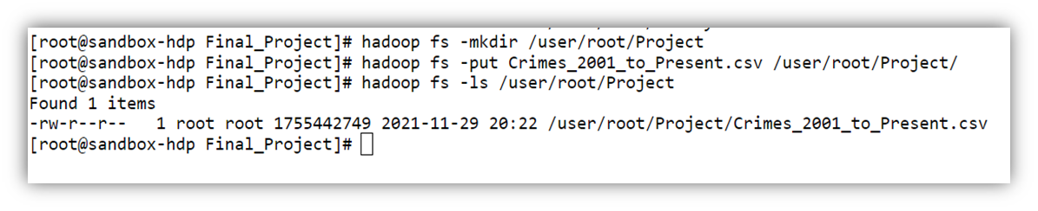
HDFS
Data Storage & Management
Steps for setting up Chicago Crime input file in HDFS:
Creating the Project Folder on HDFS:
hadoop fs –mkdir /user/root/Project
Copying the dataset to HDFS:
hadoop fs -put Crimes_2001_to_Present.csv /user/root/Project/

Slide 9


Spark
Data Processing Engine
Data
Exploration
PySpark DataFrames were used to read the input csv from HDFS
Analyzed fundamental metrics and trends for the disparate types of crime
Utilized visualization tools such as bar graphs, line graphs, and maps for appropriate illustration

Slide 10
Spark SQL
Data Querying Layer
Handling
Missing Values
Feature Selection
Balancing
Dataset
Balanced the dataset having extremely rare crime types and locations
Dropped the missing values as they accounted for less than 1% of the dataset
Factorized the dataset and filtered out relevant features from the dataset using Pearson correlation matrix

Slide 11
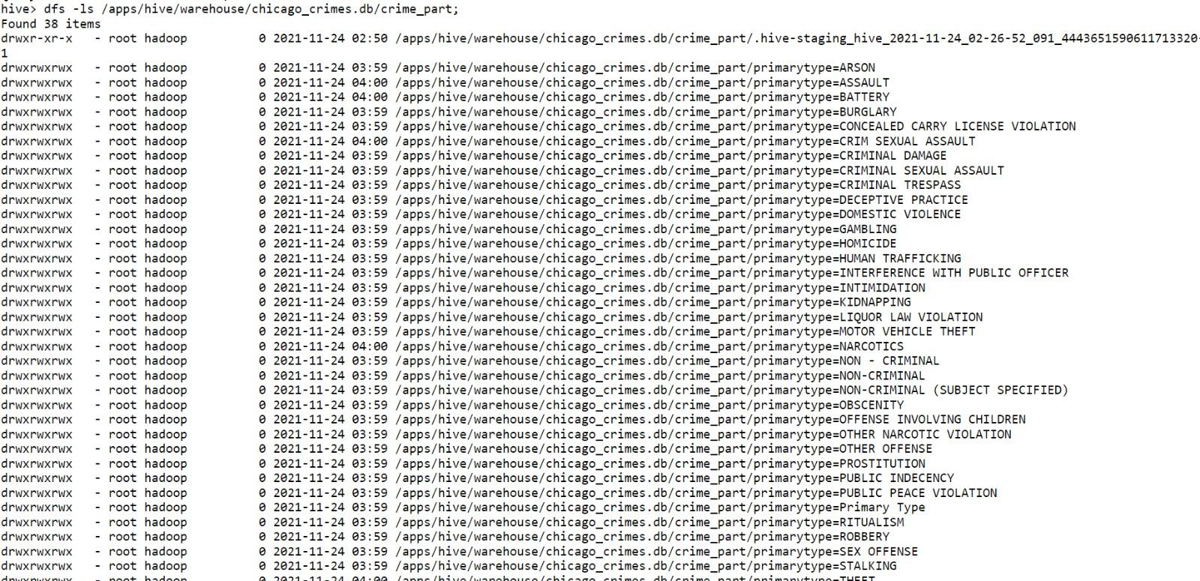
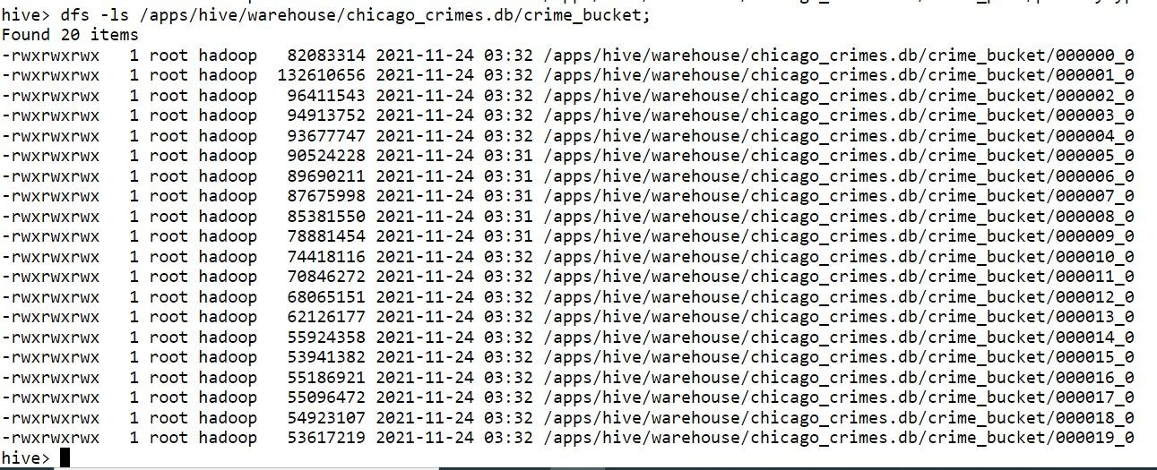
Hive
Data Warehouse
Table Structure
Partitioning on attribute primary type
Table Structure
Bucketing on attribute year

Slide 12
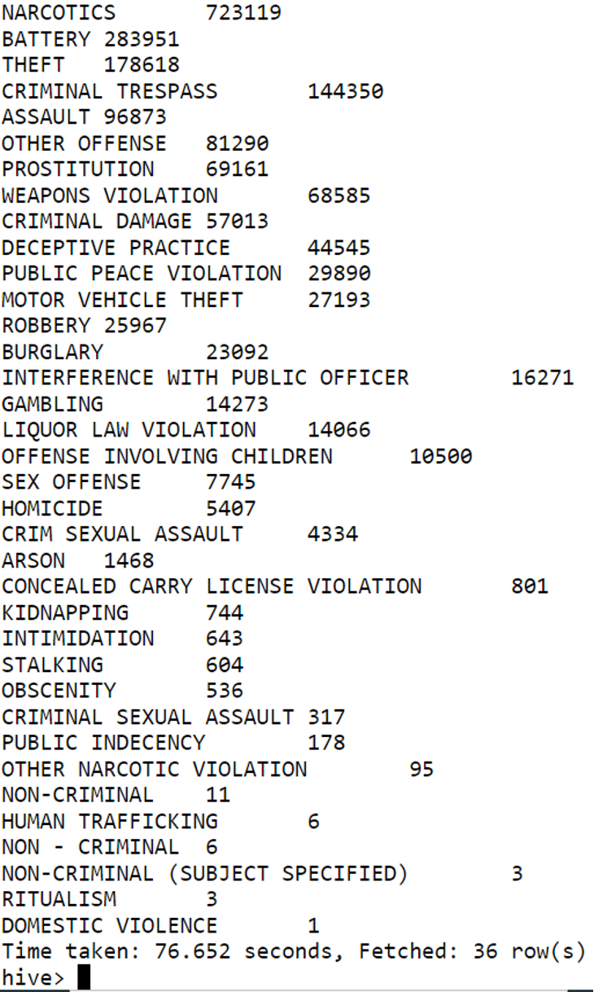
Arrests by primary type
 | All Data | Partitioned | Bucketing
Execution Time | 76.652 | 72.245 | 65.151
SELECT primarytype, COUNT(*) AS cnt FROM chicago_crimes.crime_bucket WHERE arrest = True GROUP BY primarytype ORDER BY cnt DESC

Slide 13
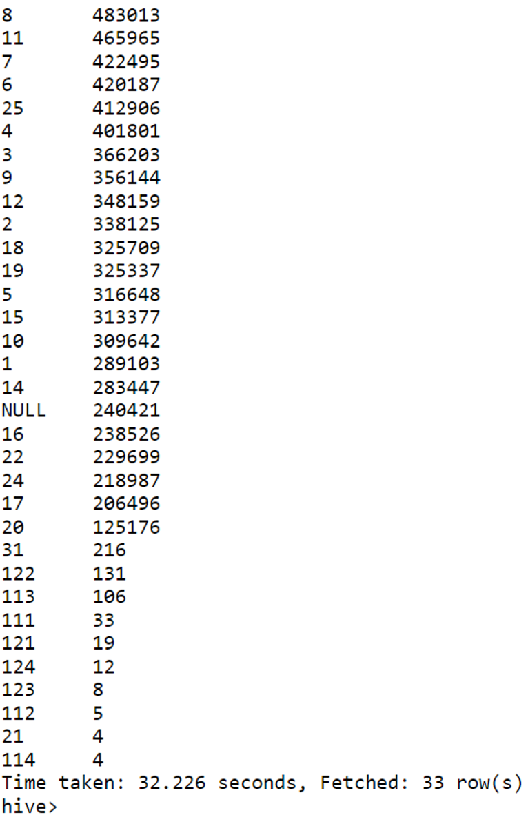
Districts with the most reported incidents
 | All Data | Partitioned | Bucketing
Execution Time | 43.478 | 39.729 | 29.22
SELECT district, COUNT(*) AS cntdistrict FROM chicago_crimes.crime_bucket GROUP BY district ORDER BY cntdistrict DESC

Slide 14


Presenting Insights

Slide 15
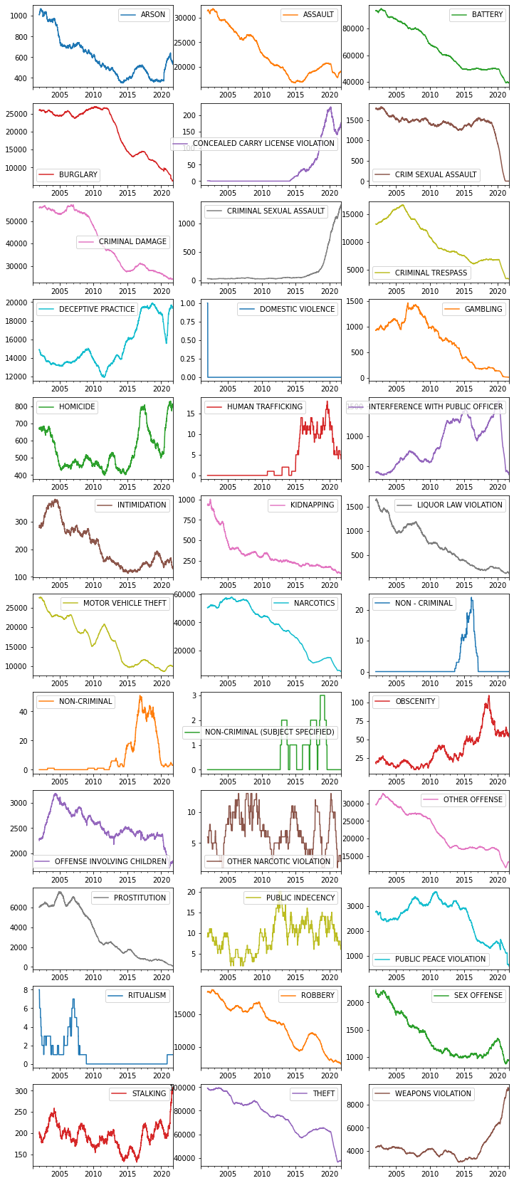
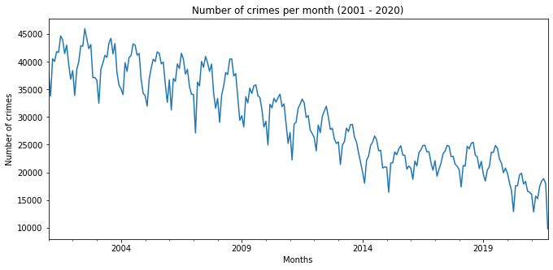
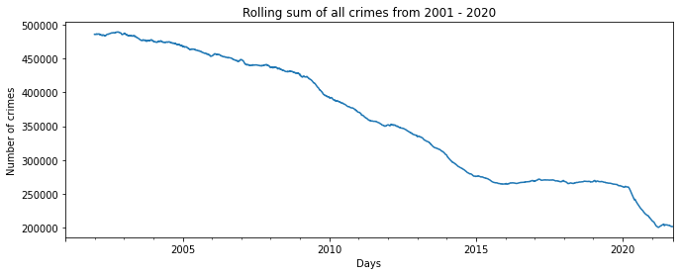
Crime Trends Over the Years
The above two graphs show a decreasing pattern of crime over the years. However, on further analysis (right graph) for each crime type, it was found not be to true as shown
Notes:
Explain about the left graph of decreasing pattern and increasing pattern in the right graph of various crimes such as human trafficking and weapons violation

Slide 16
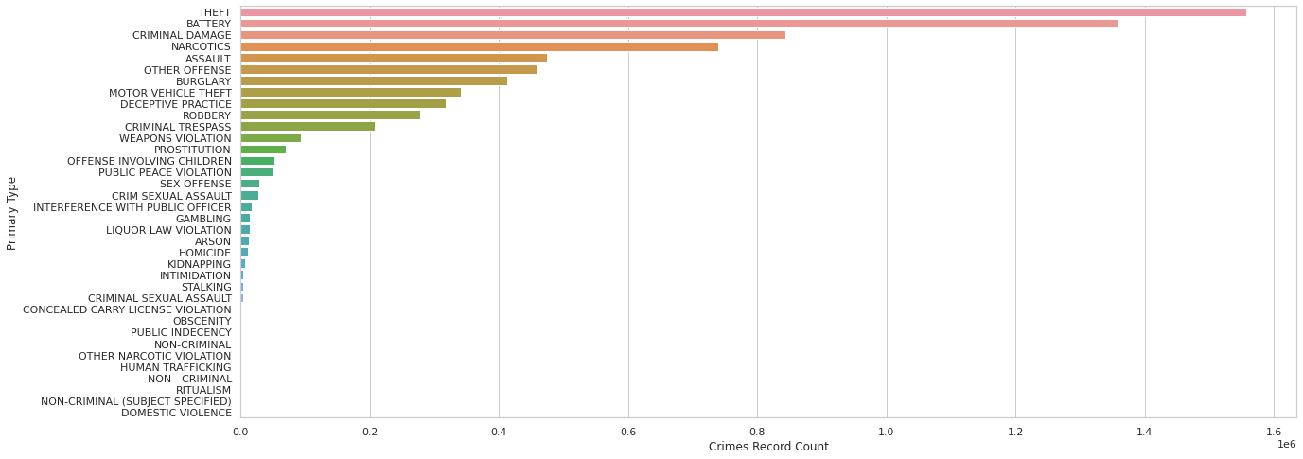
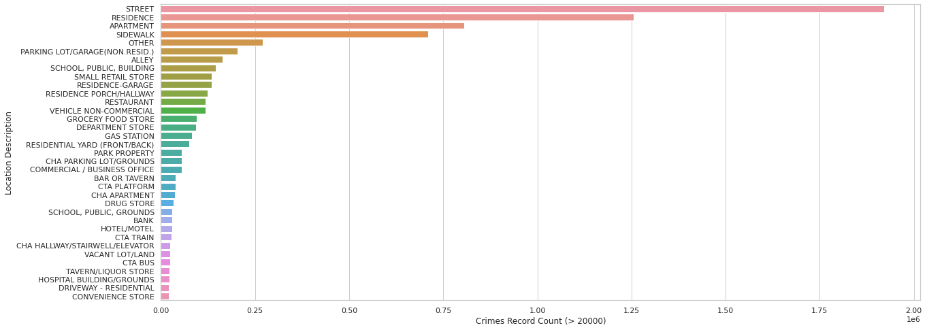
Crimes based on
Primary Type & Location
The graph depicts the distribution of crimes based on their Primary Type, among which, most crimes are Theft and Battery.
The graph depicts the distribution of crimes based on their Location, among which, most crimes occur on the Street or Residence.
Notes:
Theft and Battery, Street and Residence

Slide 17
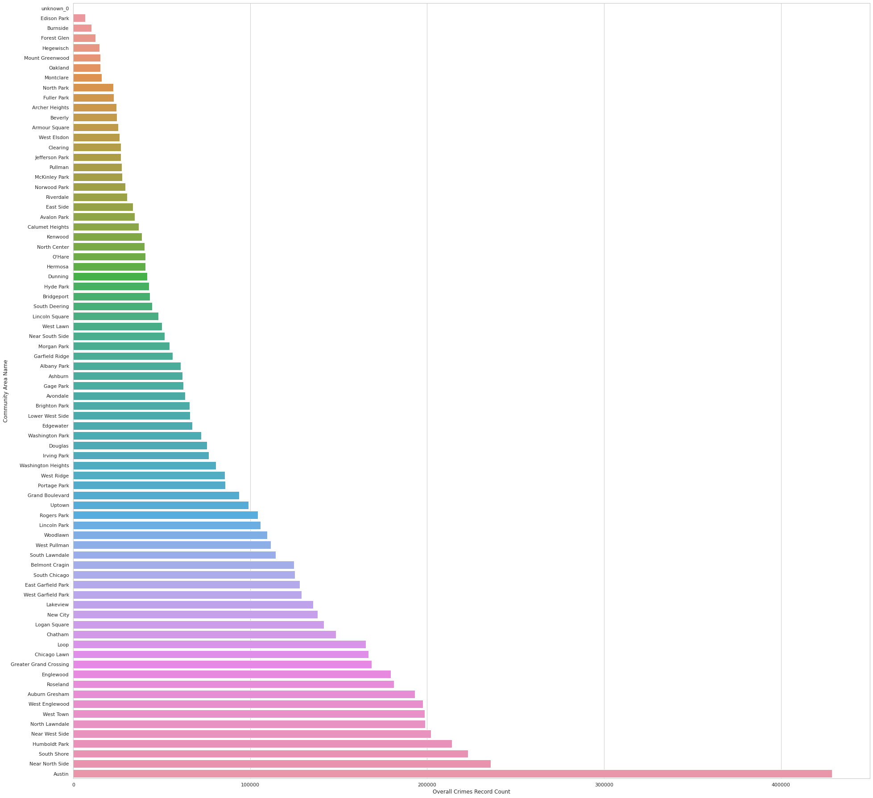
Crimes by Community Area
Notes:
Deeper dive into Community Areas, showing Austin has a drastically higher crime rate

Slide 18
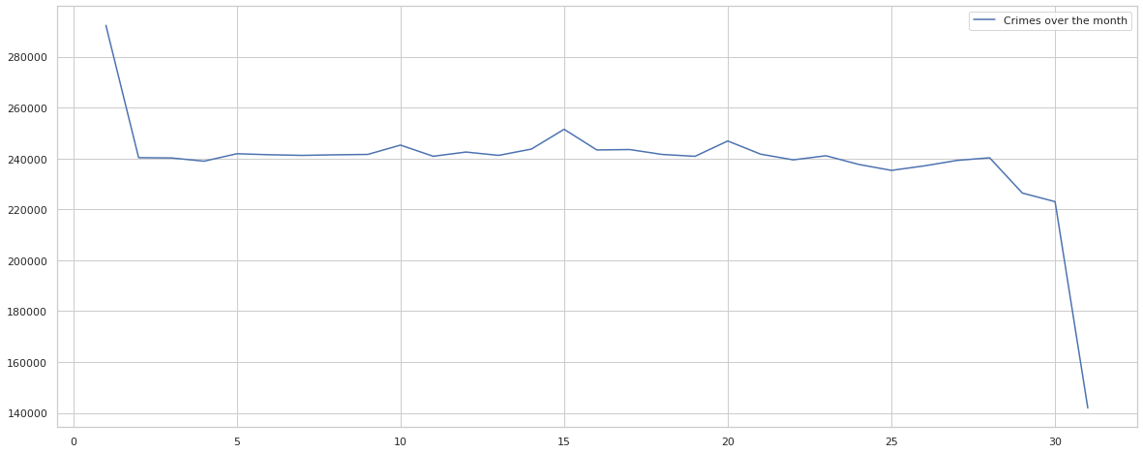
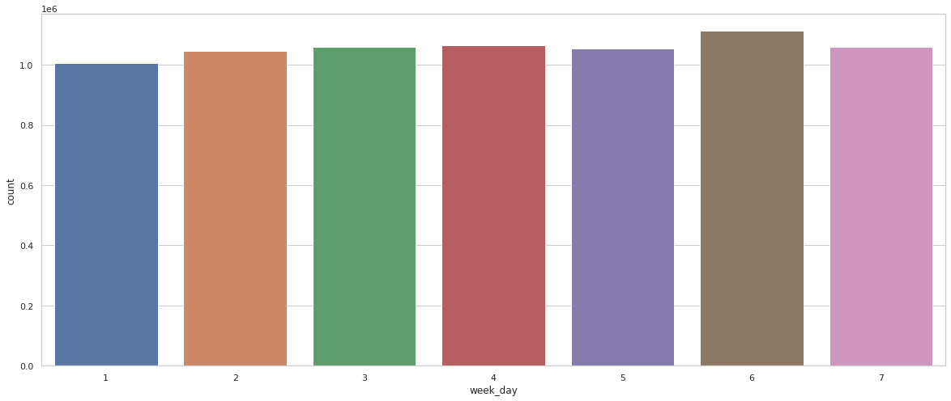
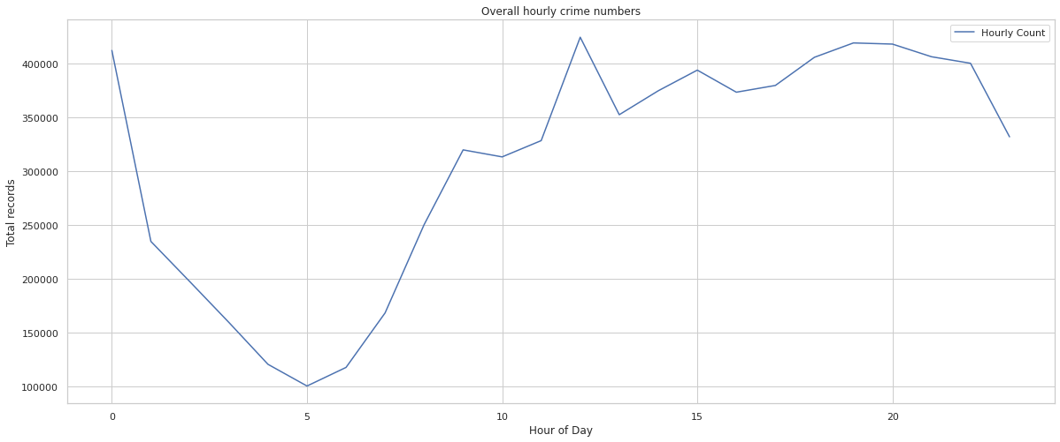
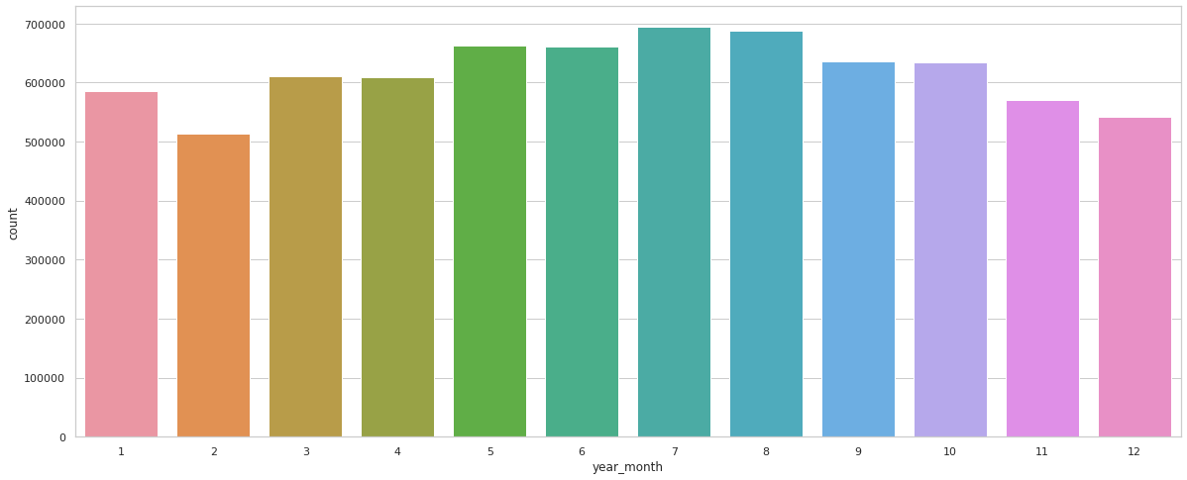
Monthly, Weekly and Hourly
Crime Analysis
Crimes over day of the month
Crimes over day of the week
Crimes over hour of the day
Crimes over month of the year
Notes:
Day - Crime rate is steady with a sharp decline towards the end
Week - Saturday has the highest crime rate out of all the days
Hour - Peaks at around 12pm of the day and around 18-22 hours have higher rates
Month - July and August have the highest crime rate among all the months

Slide 19
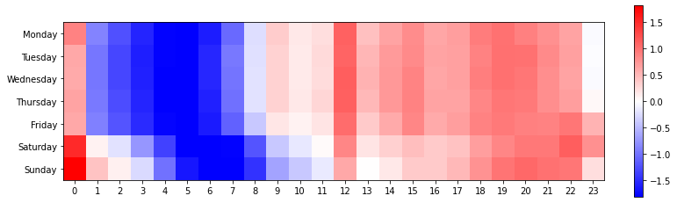
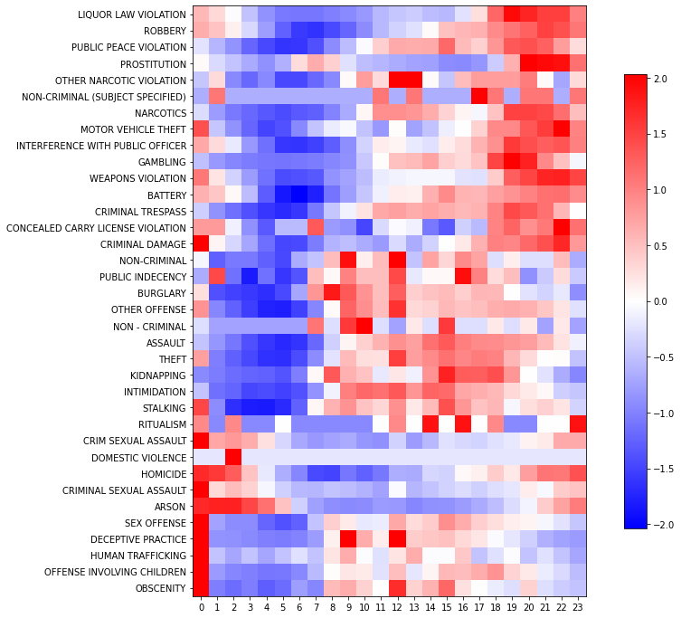
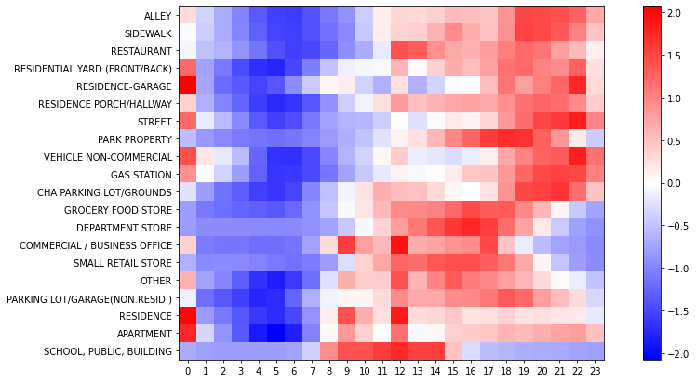
In Depth - Hourly Crime Analysis
Hour of the day vs Day of the week
Hour of the day vs Primary Type
Hour of the day vs Location
Notes:
Top Left - Here we can see that on weekdays, there is a higher crime rate towards the second half of the day
Bottom Left - couple of them peaking between 9 AM - 12 PM, rest locations such as Alley, Sidewalk see the crimes occurring during nighttime
Right - Most crimes such as Robbery peak during the night while some such as Theft peak during the day

Slide 20
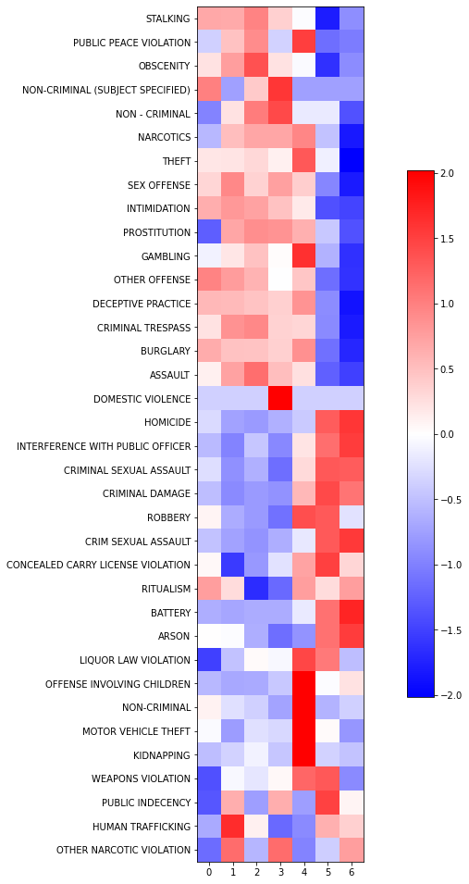
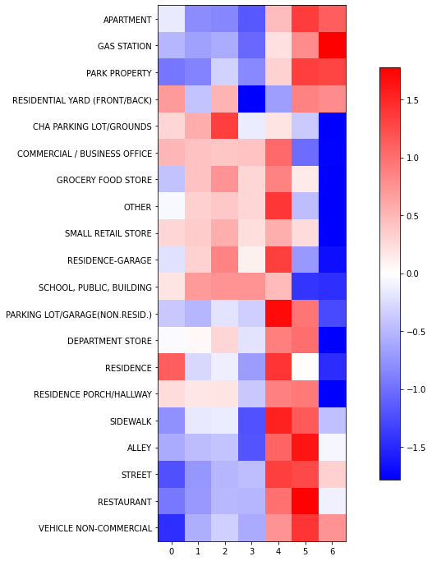
Crime Heatmap
Day of the week by Primary type
Day of the week by Location
Notes:
Left graph - Some crime’s types peak at specific days of the week (like Friday or Saturday). Other types are more like weekday crime.
Right Graph - Some crimes occur at specific locations during particular days of the week. Ex Majority Apartment crimes occurring on the weekend

Slide 21
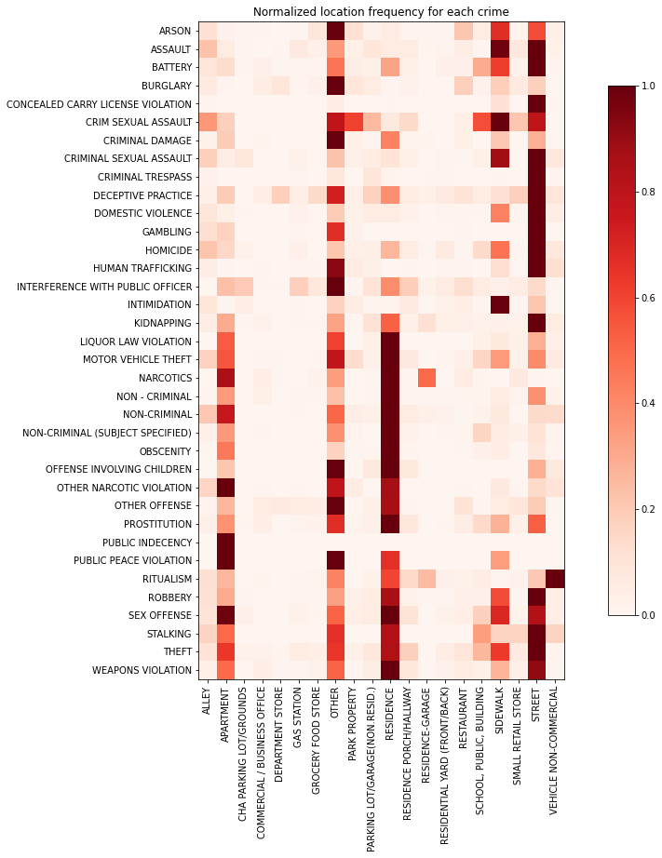
Location vs Primary Type
In this analysis, we have taken each crime type and re-normalized its location frequency to be between zero and one. This way, we can look at the top frequent locations of each crime type (darker red reflects a more frequent location).
It appears that most crimes occur at either apartments, residences, sidewalks, streets, or 'other'.

Slide 22
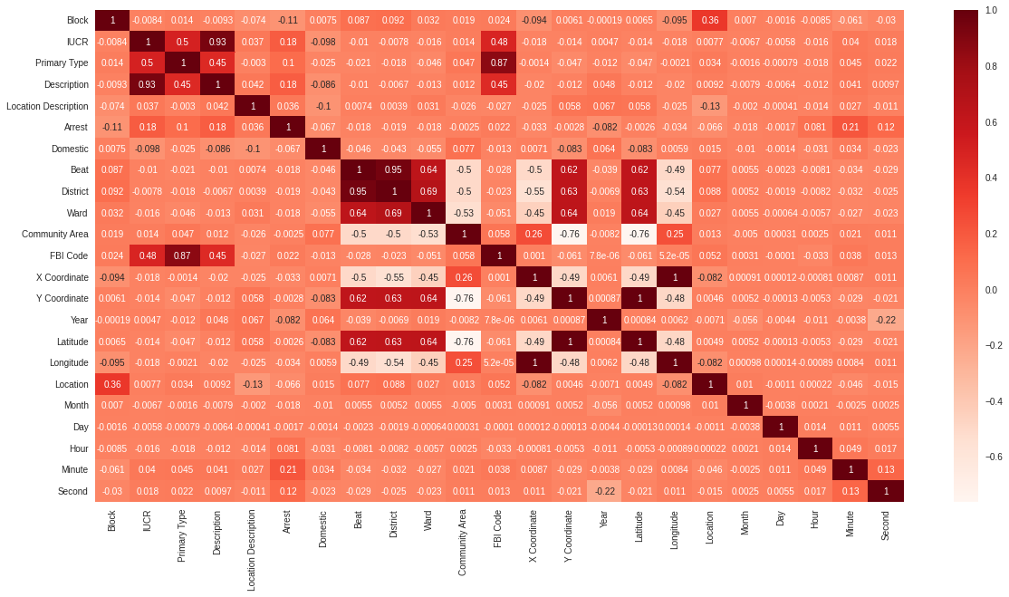
Predictive Modelling
Feature Selection

Slide 23
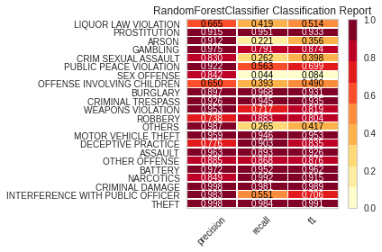
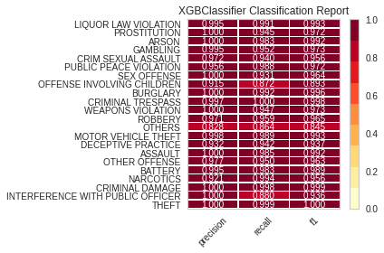
Model Building & Evaluation
Random Forest
Accuracy : 0.93072
Recall : 0.93072
Precision : 0.9341
F1 Score : 0.93072
XGBoost
Accuracy : 0.98318
Recall : 0.98318
Precision : 0.9837
F1 Score : 0.98318
RandomForestClassifier
n_estimators=70
min_samples_split = 30
bootstrap = True
max_depth = 50
min_samples_leaf = 25
XGBClassifier
n_estimators=100
max_depth=3

Slide 24
Future Work &
Lessons Learned
For future work, to boost the classification accuracy, it will be necessary to incorporate other information. Additionally, some events and the outcomes of the events may be associated with some crime types, for example, basketball games, baseball games, and elections. Weather information and classification of buildings can also be incorporated.
In our exploratory data analysis, we revealed that several features, for example location of the crime scene and the time of the crime, are associated with the type of crime, providing the basis for out modeling later. Hence, one single feature may not be sufficient for determining the type of crime, but a combination of various features can be powerful.
The end goal would be to create a web application portal that receives an address or location and time arguments in Chicago from the user and predicts the probability of crime (hence safety) at a specific location and a particular time.
In conclusion, we have learnt and implemented the tools to the best of our knowledge taught in the course.

Slide 25
Thank You!
Any Questions?

